Slide 1
CASE STUDY : YouTube
Akar Gupta S3808546
Anurag Dinesh Karmarkar S3829070
Chinmay Pradeep Karangutkar S3827733
Siddharth Kumar S3816208
Notes:
Hello everyone How are you?? . I'm Chinmay Karangutkar .
On behalf of Data Drivers , i'd like to welcome you.
today we are going to talk about our case study on Youtube Kids.
Now let's get started.

Slide 2

YouTube is an online video sharing platform currently owned by Google.
YouTube allows users to watch videos posted by other users.
After Google, YouTube is one of the biggest search engine which provides video content.
Recently, YouTube was caught collecting children's data from their YouTube Kids Platform without the consent of children’s parents.
Notes:
Have you heard about this video sharing platform "YouTube" ? Off course we have!!.
Everyone uses it on a daily count
YT is biggest search engine after google & is used on very large scale.
Yt has a separate platform for kids named yt kids where the kids content is separeted from rest.
case :-- ppt refer
it is considered as big Threat to privacy .

Slide 3

CASE STUDY BREAKDOWN
Idea Behind YouTube Kids:
- Exclusive platform for kids
- Parental Consent required for Sign-Up
Implementation :
- Data Collection without consent
- Targeted Advertisements
This Photo by Unknown author is licensed under CC BY-SA.
Notes:
The purpose behind creating, YouTube Kids, a platform specially catering to kids was to show them only children-friendly content. The platform would also use parental control to restrict the content shown to the children. All this sounded good at first. However, when the platform was launched, there seemed to be something wrong. Upon investigation, it was found that the true purpose of creating a separate platform for children was to collect their data. YouTube was then found to be using this data to show targeted advertisements to the children. To make matters worse, this was being done without the consent of the parents / guardians.

Slide 4
F.A.T.E
Transparency
Did not come through about gathering kids' data.
Not giving a clear indication what and how much data is collected.
Using data to generate revenue by targeted advertising.
It's unclear was this data shared with any third parties or not.
Ethics
By collecting data of Children YouTube did something completely opposite of what they promised.
Did not take approval of Parents/ Guardians.
Broke the trust of its users.
Notes:
Fate stands for Fairness , accountability, Transparency & Ethics.
After analyzing our case study we can clearly establish that the algorithm and methods used by YouTube violates Transparency & Ethic principles.
Looking at transparency and In this case YouTube has disregarded it at two folds. Firstly by not being transparent about gathering data of kids and to what extent.
Secondly using this restricted data to generate revenue by targeted advertising. They hid this information and people still don’t know was this data shared with any other party or not.
Ethics in this case can be summed up by stating that YouTube kids was started so that the data of kids will not be collected and the exact opposite was done.
Moreover they didn’t bother to take permission from parents and by doing this they broke the trust of its users.
Because of such violations of the statutory laws google is facing legal ramification from state of mas and few other about which we have gone in details length in our report.

Slide 5
DESIRABLE APPROACH
Big TECH
Being transparent about what kind of data is being collected and who shared with.
Expand the GDRP principle to other facet of their ML models, giving user access to their collected data.
Provide options for opt in or out of service designed to “better” server customers based on their personal data.
GOVERNMET INSITUTION
Enact new laws and expand current one for consumer data protection.
Create new oversight committee to monitor the companies' data collection and handling polices.
Impose increasing fines.

Slide 6
CONCLUSION
Legal case against YouTube Kid for collection children's data without parental consent.
Questionable user data collection practices.
Move towards ML model base on FATE principle.
Introduction of new legislation from government entities.

Slide 7
CONTRIBUTION SHEET
Speaker | Slide Number | Content
Chinmay Karangutkar | 2 | Introduction
Anurag Karmarkar | 4 | Case Study Breakdown
Akar Gupta | 5 | F.A.T.E
Siddharth Kumar | 6 & 7 | Desirable Approach & Conclusion

Slide 8
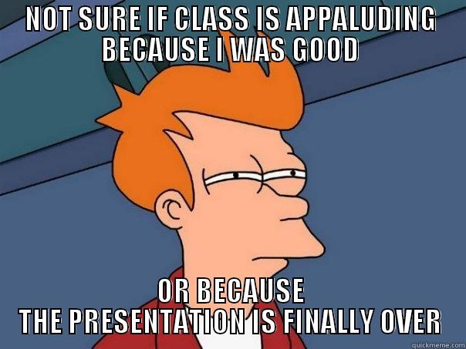
That’s All :)
Thank you

